Slide 1
Data Science New Field … No Textbook
Machine Learning
Efficient Reusable Code:
You use C/C++ or Java
Data Visualization:
You use D3js

Slide 2
Outline
Setting up a professional computational environment.
Data Science: Known unkowns.
Computer Science Basics: OOP
Basic feature Engineering. ML algorithms?
Advanced Sklearn

Slide 3
A Word On OS’s
Most data scientists use OSX / Linux.
ALL data scientists need to be fluent with UNIX command line. Programs to know:
scp -- (secure copy) move files between computers
ssh -- (secure shell) work on a remote computer
vim (or pico or emacs) -- a text editor

Slide 4
Tools Everyone Needs:
Ipython terminal & Ipython notebook
A text editor. Pick one and master it.
SQL (consider installing it on your laptop)
GIT
A good visualization library. Pick one and master it. (Matplotlib, Bokeh, Seaborn)

Slide 5
Outline
Setting up a professional computational environment.
Data Science: Known unkowns.
Computer Science Basics: OOP
Basic feature Engineering. ML algorithms?
Advanced Sklearn

Slide 6
If You Are Coming From Statistics Side…
Take the time to learn a statically typed language (C++ or Java/Scala) and really think about data structures and when/why they are used.
Arrays (python -- numpy)
Linked lists (python -- list)
Hashing (python – set & dict )
Learn about object oriented design
Learn to use GIT

Slide 7
If You Are Coming From CS Side
Think critically about your data. Model preforms really well? You probably did something wrong.
Scikit learn API is a very dangerous thing.
Data science is a science and not product. Not all questions are answerable. Agile methods generally don’t apply.
The metric “Accuracy” is more or less meaningless. Get serious, never use it.

Slide 8
The Basics: ML Algorithms to know
Cross Validation
LOGISTIC REGRESSION
K-Nearest Neighbors
Random Forrest
K-Means Clustering
Neural Networks

Slide 9
I Highly Recommend:
Try implementing your own Machine Learning algorithms.
“What I cannot create I do not understand”
Obviously don’t use your own implementation for any practical work.

Slide 10
Think Like A Scientists!!!!

Slide 11
Setup Git
https://github.com/jfried23/
ML_Summer2017.git
https://drive.google.com/open?id=0B0VIrTNU3vr_UVZKc2VmYUFCSTg

Slide 12
Outline
Setting up a professional computational environment.
Data Science: Known unkowns.
Computer Science Basics: OOP
Basic feature Engineering. ML algorithms?
Advanced Sklearn

Slide 13
OOP In Ten Minutes…or less?

Slide 14
Outline
Setting up a professional computational environment.
Data Science: Known unkowns.
Computer Science Basics: OOP
Basic feature Engineering. ML algorithms?
Advanced Sklearn

Slide 15
True Statistics About Machine Learning That I Just Made Up

Slide 16
True Statistics About Machine Learning That I Just Made Up II

Slide 17
Central Theory of Supervised Machine Learning
Some Matrices of Features X
Some Function of X:
h(X)
Some Target Values Y
Size (ft²) | Style | …. | Neighborhood | Year Built
1,200 | Spanish |  | Oak Forrest | 1974
4,000 | Tudor |  | Park Glenn | 1953
2,600 | Rach |  | Deer Run | 1995
3,600 | Modern |  | Oak Forrest | 1973
1,800 | Spanish |  | Ridgewood | 2001
Market Value
$120,000
$350,000
$225,000
$530,000
$183,000

Slide 18
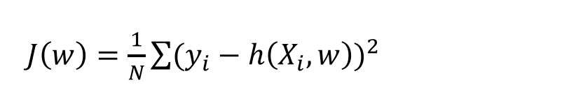
ML IS The Minimization of A Cost Functions
Hypothesize:
Target Value Y
h(X,w) = w₁*x + w₀
Some Feature X

Slide 19
What's wrong with our existing features?
Some Matrices of Features X
Some Function of X:
h(X)
Some Target Values Y
Size (ft²) | Style | …. | Neighborhood | Year Built
1,200 | Spanish |  | Oak Forrest | 1974
4,000 | Tudor |  | Park Glenn | 1953
2,600 | Rach |  | Deer Run | 1995
3,600 | Modern |  | Oak Forrest | 1973
1,800 | Spanish |  | Ridgewood | 2001
Market Value
$120,000
$350,000
$225,000
$530,000
$183,000

Slide 20
What Features Can You Make?
Shape 1
Shape 2
Shape 3
Shape 4
Shape 5

Slide 21
What Features Would You Use To Classify?
Positive Review
Negative Review
April 2, 2017 8:43 AM EST: USER 14325.
I have bought several of the Vitality canned dog food products and have found them all to be of good quality. The product looks more like a stew than a processed meat and it smells better. My Labrador is finicky and she appreciates this product better than most.
June 5, 2014 12:43 PM PST: USER 8530.
Product arrived labeled as Jumbo Salted Peanuts...the peanuts were actually small sized unsalted. Not sure if this was an error or if the vendor intended to represent the product as "Jumbo".

Slide 22
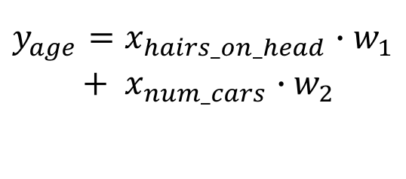
Real Numbers: Feature Scaling
In [4]: df = pd.DataFrame(data={’Age':[28,17,43,85,19],
'Hairs':[94e3,121e3,87e3,63e3,154e3],
'Cars':[1,0,2,0,1]})
In [5]: df.head()
Out[5]:
Cars Hairs Age
0 1 94000.0 28
1 0 121000.0 17
2 2 87000.0 43
3 0 63000.0 85
4 1 154000.0 19
In [6]: SS = preprocessing.StandardScaler(
with_mean=True, with_std=True)
In [7]: df[['Hairs','Cars']]=SS.fit_transform( df[['Hairs','Cars']])
In [8]: df.head()
Out[8]:
Age Cars Hairs
0 28 0.267261 -0.314374
1 17 -1.069045 0.551758
2 43 1.603567 -0.538927
3 85 -1.069045 -1.308822
4 19 0.267261 1.610365
Age | Hairs On Head | Cars
28 | 94,000 | 1
17 | 121,000 | 0
43 | 87,000 | 2
85 | 63,000 | 0
19 | 154,000 | 1

Slide 23
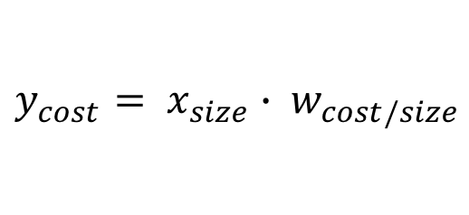
Categorical Data (Ordinal)
In [1]: import sklearn
In [2]: from sklearn import preprocessing
In [3]: import pandas as pd
In [4]: shirts =pd.DataFrame(data=
{'Size':['Large','Small', 'Medium', 'Large', ‘Small']})
In [5]: shirts.head()
Out[5]:
Size
0 Large
1 Small
2 Medium
3 Large
4 Small
In [6]: le = preprocessing.LabelEncoder()
In [7]: le.fit_transform(shirts.Size)
Out[7]: array([0, 2, 1, 0, 2])
Small
Medium
Large
Cost
Size

Slide 24
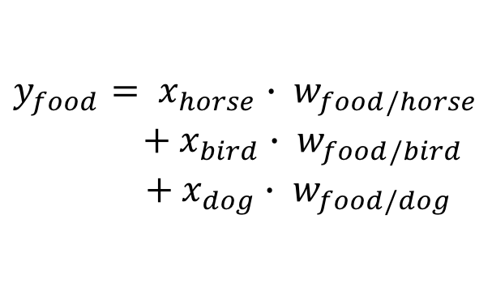
Categorical Data (Non-Ordinal)
In [1]: import sklearn
In [2]: from sklearn import preprocessing
In [3]: import pandas as pd
In [4]: animal = pd.DataFrame(data={'Animal':['Dog','Horse', 'Bird', 'Dog', 'Horse']})
In [5]: animal.head()
Out[5]:
Animal
0 Dog
1 Horse
2 Bird
3 Dog
4 Horse
In [6]: ohe=preprocessing.OneHotEncode()
In [7]: ohe.fit_transform(animal.Animal)
Out[7]:
array([[0, 1, 0],
[0, 0, 1],
[1, 0, 0],
[0, 1, 0],
[0, 0, 1]])
Horse
Bird
Dog
Food
?
Animal

Slide 25
Imputation
In [4]: df = pd.DataFrame(data={’Age':[np.nan,17,43,85,19],'Hairs':[94e3,np.nan,87e3,np.nan,
...: 154e3],'Cars':[1,0,2,0,np.nan]})
In [4]: df.head()
Out[4]:
Age Cars Hairs
1 NaN 1.0 94000.0
2 17.0 0.0 NaN
3 43.0 2.0 87000.0
4 85.0 0.0 NaN
5 19.0 NaN 154000.0
In [5]: freq_impute = preprocessing.Imputer(
strategy='most_frequent')
In [6]: freq_impute.fit_transform(df)
Out[6]:
array([[ 1.7e+01, 0.0e+00, 8.7e+04],
[ 4.3e+01, 2.0e+00, 8.7e+04],
[ 8.5e+01, 0.0e+00, 8.7e+04],
[ 1.9e+01, 0.0e+00, 1.5e+05]])
In [48]: mean_impute = preprocessing.Imputer(strategy='mean')
In [50]: mean_impute.fit_transform(df)
Out[50]:
array([[ 1.7e+01, 0.0e+00, 1.2e+05],
[ 4.3e+01, 2.0e+00, 8.7e+04],
[ 8.5e+01, 0.0e+00, 1.2e+05],
[ 1.9e+01, 6.7e-01, 1.5e+05]])
df.dropna()
Age | Hairs On Head | Cars
43 | 87,000 | 2
Age | Hairs On Head | Cars
NaN | 94,000 | 1
17 | NaN | 0
43 | 87,000 | 2
85 | NaN | 0
19 | 154,000 | NaN
df.dropna(subset=‘Age’)
Age | Hairs On Head | Cars
17 | NaN | 0
43 | 87,000 | 2
85 | NaN | 0
19 | 154,000 | NaN

Slide 26
Polynomial Features
In [4]: df = pd.DataFrame(data={'x':range(0,6)})
In [5]: df.head()
Out[5]:
x
0 0
1 1
2 2
3 3
4 4
In [6]: pf =preprocessing.PolynomialFeatures( degree=3, interaction_only=False,
include_bias=False)
In [7]: pf.fit_transform(df)
Out[7]:
array([[ 0., 0., 0.],
[ 1., 1., 1.],
[ 2., 4., 8.],
[ 3., 9., 27.],
[ 4., 16., 64.],
[ 5., 25., 125.]])
Y = w₁*x + w₂*x²
Y = w₁*x + w₂*x² + w₃*x³
Y = w1*x

Slide 27
Outline
Setting up a professional computational environment.
Data Science: Known unkowns.
Computer Science Basics: OOP
Basic feature Engineering. ML algorithms?
Advanced Sklearn

Slide 28
Overview of Sklearn API: Create The Model
from sklearn import linear_model
Your Model
Your Hyperparameters
rc = linear_model.RidgeClassifier( alpha=1.0,
fit_intercept=True,
normalize=False,
copy_X=True,
max_iter=None,
tol=0.001,
class_weight=None,
solver=’auto',
random_state=None)

Slide 29
Overview of Sklearn API: Train the Model to Find Optimal Paramaters
rc = linear_model.RidgeClassifier(…….)
Your Model
Your features
Your Answers
rc.fit( X_training_features, y_training_answers )
Predicted output
Your testing features
predictions = rc.predict( X_test_features )

Slide 30
Overview of Sklearn API: Evaluate The Model
rc = linear_model.RidgeClassifier(…….)
rc.fit( X_training_features, y_training_answers )
predictions = rc.predict( X_test_features )
Now do it again with different hyperparameters!!!!

Slide 31
True Statistics About Machine Learning That I Just Made Up III

Slide 32
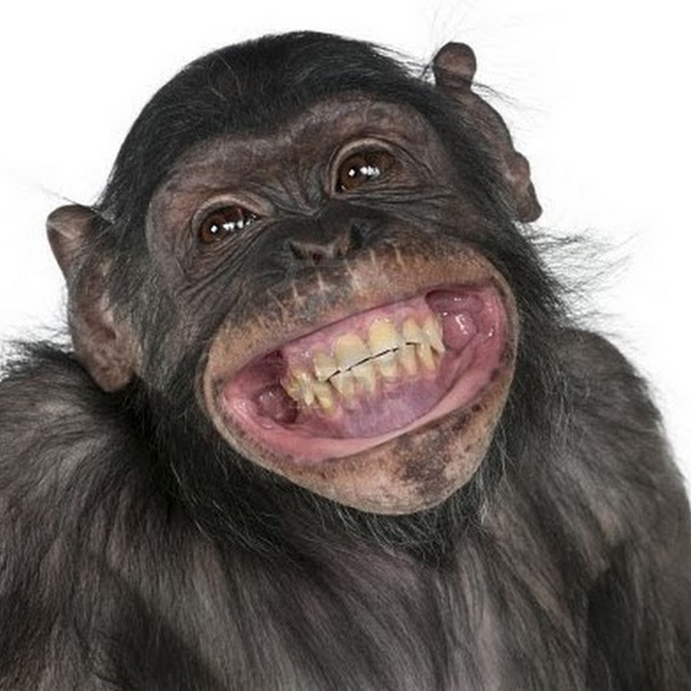
I Plug Things Into sklearn!

Slide 33
https://www.kaggle.com

